Slide 1

Predicting Popularity Score of Songs Using Spotify Track Dataset
By:
Pragnya – SRN:PES2UG21CS380,
Shreya – PRN:PES2202200288

Slide 2
This project is about getting inferences by understanding the data between various parameters like loudness and popularity or danceability and popularity.
We then try and predict the popularity score of a song by providing all the different parameters.
We try and use multiple different models such as Multiple Linear Regression Model, Decision Tree Model, Support Vector Regression, and Random Forest, and test the accuracies.

Slide 3
INFERENCES
trying to understand the effect of different parameters individually of the popularity of the song!

Slide 4
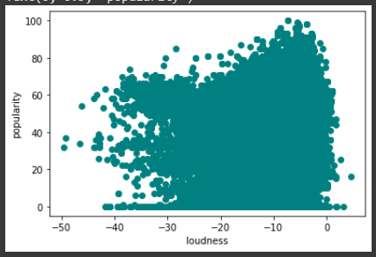
Loudness VS Popularity

Slide 5
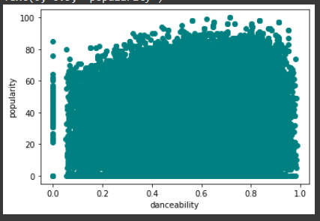
Danceability VS Popularity

Slide 6
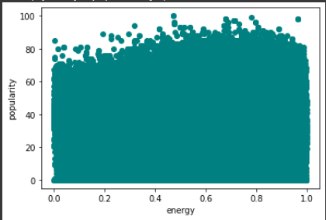
Energy VS Popularity

Slide 7
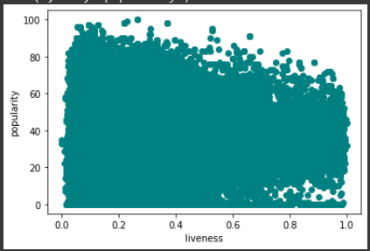
Liveness VS Popularity

Slide 8
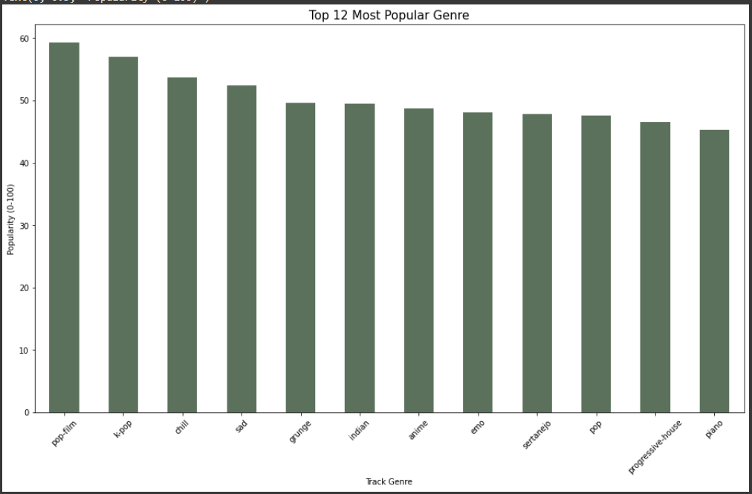
Popularity VS Genre

Slide 9
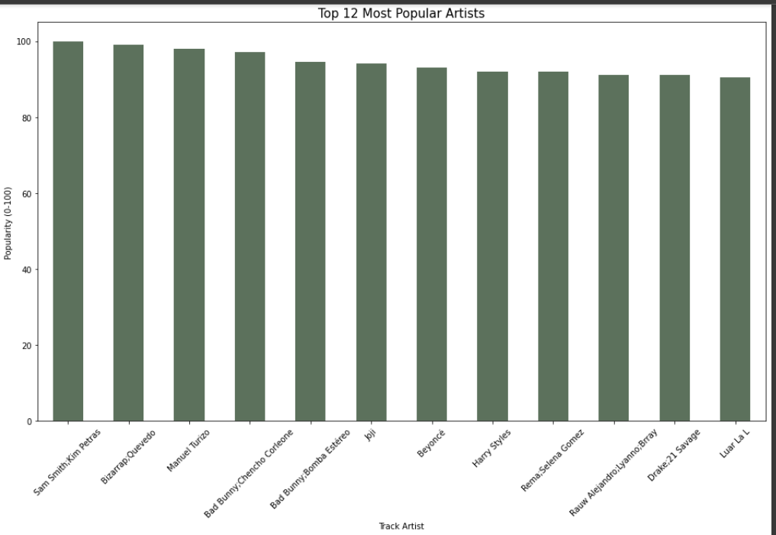
Popularity VS Track Artist

Slide 10
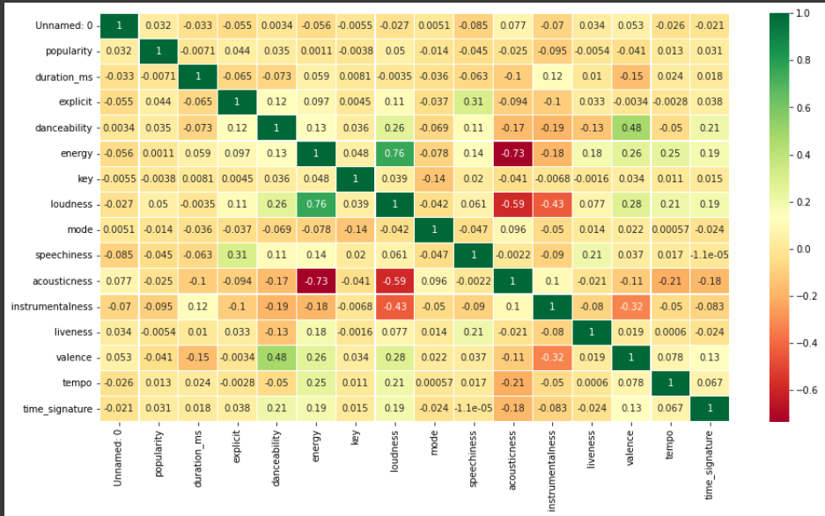
HEATMAP
This determines the correlation coefficient between all the numerical parameters.
We can visualize the main parameter of interest across all the parameters.

Slide 11

MODELLING
trying to find the best model fit for this dataset

Slide 12
Regression Evaluation Models Used
R-squared:
It represents the scatter around the line of best fit, or more specifically, the extent of the proportion of variance in the dependent variable which can be explained.
The higher the R-squared, the better the model fits your data.
To make things simpler we have referred to the R-squared percentages as accuracy of the regression model.
Mean Squared Error:
The average of the squared differences between the predicted values and actual values.
The lower the value of MSE, the better the model fits the data.

Slide 13
Multiple Linear Regression
After running a Multiple Linear Regression Model on the dataset we got
1. Training accuracy of 2.87%
2 . Testing accuracy of 3.04%
MSE: 483.9113
Clearly this model isn’t fit for running this dataset due to the very low accuracy.

Slide 14
Random Forests
After running a Random Forests Model on the dataset we got:
1. Training accuracy of 88.23%
2 . Testing accuracy of 88.44%
MSE: 57.5562
Result: This would be the best fit model to predict the popularity of a song since both the training and testing accuracy is high.

Slide 15
Decision Tree
After running a Decision Tree Model on the dataset we got
1. Training accuracy of 96.77%
2 . Testing accuracy of 2.53%
MSE: 485.3317
Result: Despite the training accuracy being high, the testing accuracy isn’t high, we say that this model doesn’t give us a proper reliable prediction.

Slide 16

Final Results!
Random Forest Model is the best model for predicting the popularity of the song!

